Slide 1
Section 7.2
Right Triangle Trigonometry
Copyright © 2012 Pearson Education, Inc. Publishing as Prentice Hall.

Slide 2
Copyright © 2012 Pearson Education, Inc. Publishing as Prentice Hall.

Slide 3
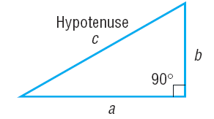

Copyright © 2012 Pearson Education, Inc. Publishing as Prentice Hall.

Slide 4
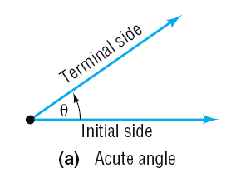
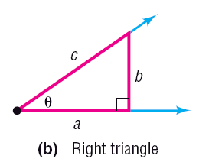
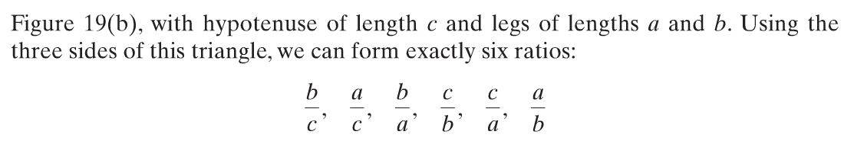
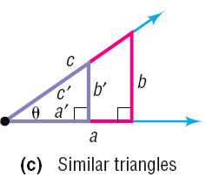
Figure 19 (b)
Copyright © 2012 Pearson Education, Inc. Publishing as Prentice Hall.

Slide 5
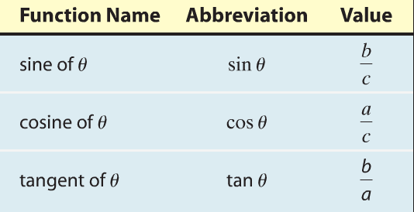
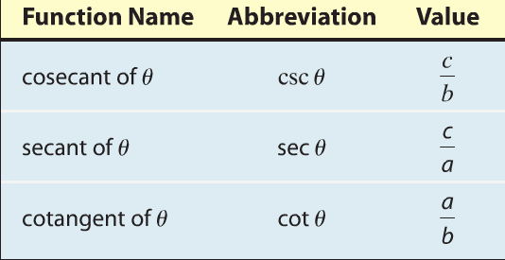
Trigonometric Functions of Acute Angles
Copyright © 2012 Pearson Education, Inc. Publishing as Prentice Hall.

Slide 6
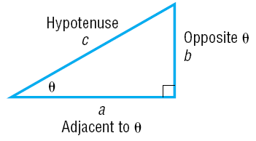
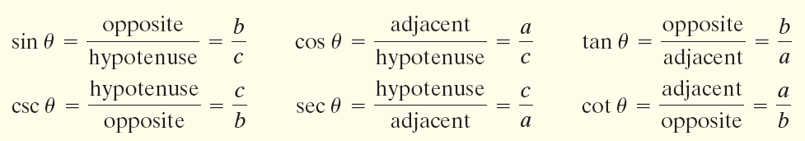
Copyright © 2012 Pearson Education, Inc. Publishing as Prentice Hall.

Slide 7

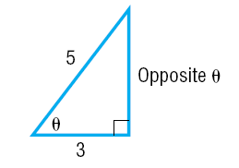
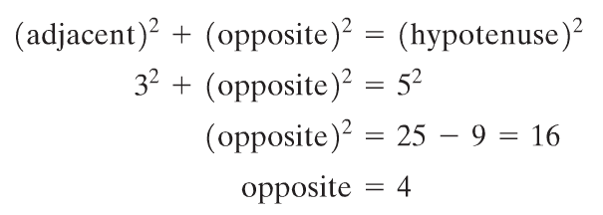
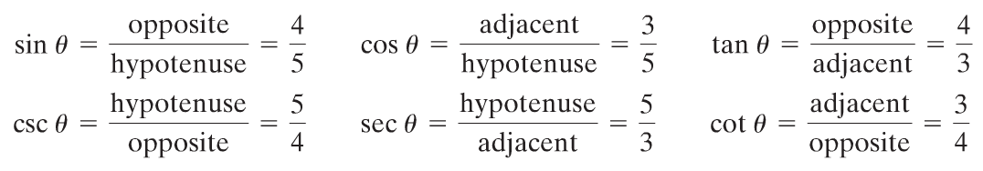
Find the value of each of the six trigonometric functions of the angle θ.
Copyright © 2012 Pearson Education, Inc. Publishing as Prentice Hall.

Slide 8
Copyright © 2012 Pearson Education, Inc. Publishing as Prentice Hall.

Slide 9




Copyright © 2012 Pearson Education, Inc. Publishing as Prentice Hall.

Slide 10
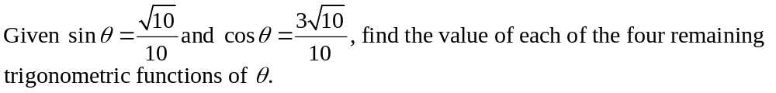
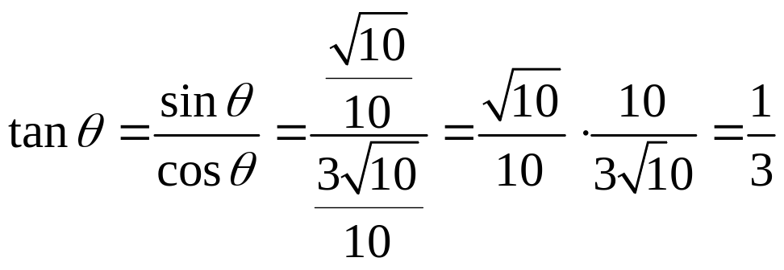
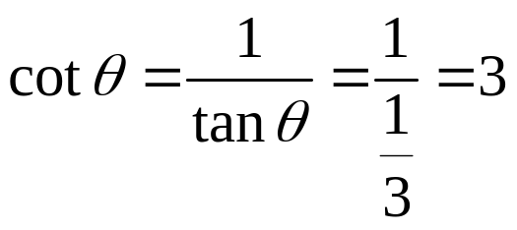
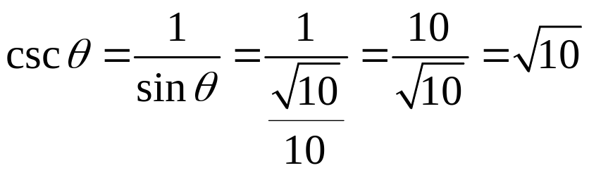
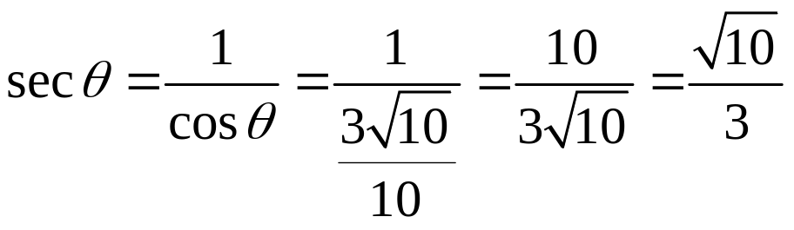
Copyright © 2012 Pearson Education, Inc. Publishing as Prentice Hall.

Slide 11
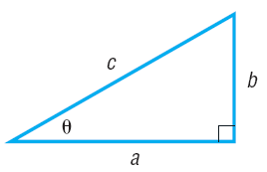

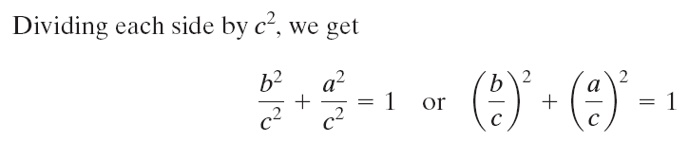

Copyright © 2012 Pearson Education, Inc. Publishing as Prentice Hall.

Slide 12
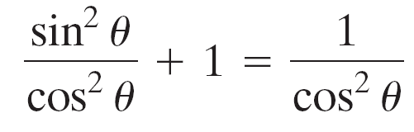


Copyright © 2012 Pearson Education, Inc. Publishing as Prentice Hall.

Slide 13

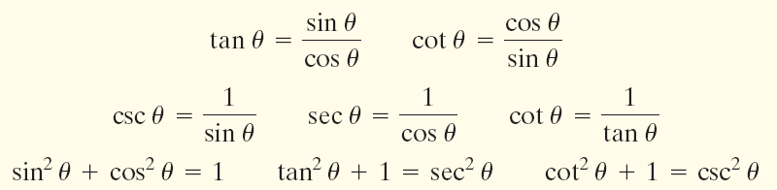
Copyright © 2012 Pearson Education, Inc. Publishing as Prentice Hall.

Slide 14

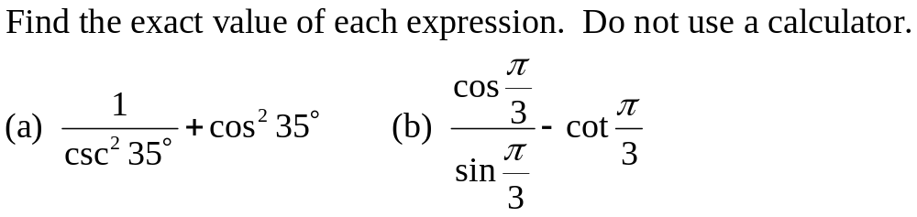
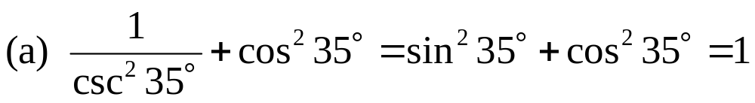


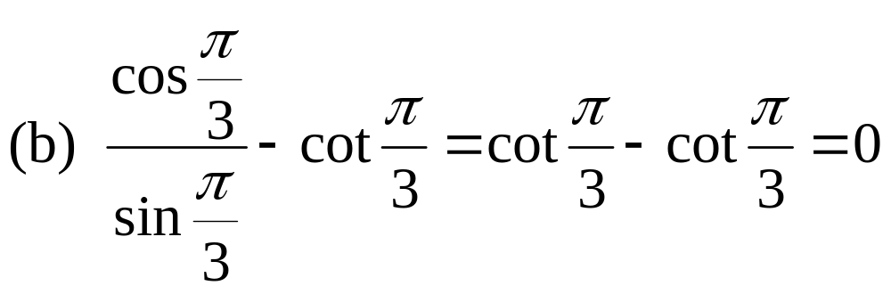

Copyright © 2012 Pearson Education, Inc. Publishing as Prentice Hall.

Slide 15
Copyright © 2012 Pearson Education, Inc. Publishing as Prentice Hall.

Slide 16


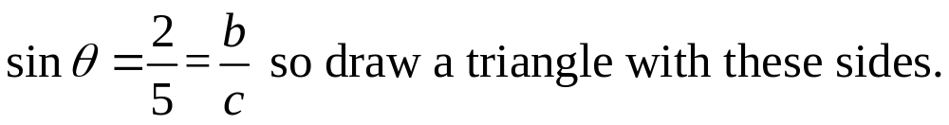

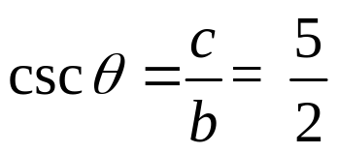

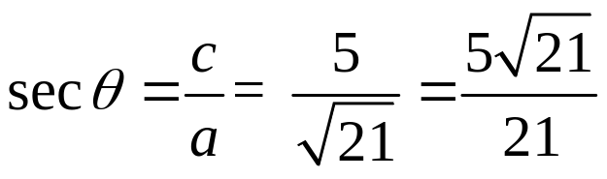

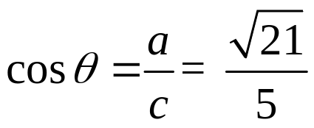
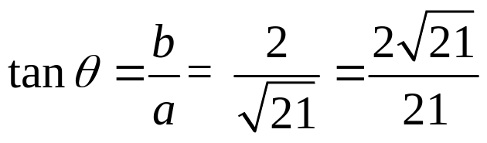
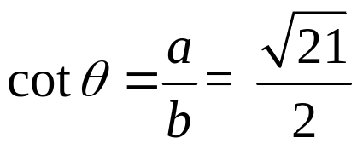
c = 5
b = 2
θ
a
Copyright © 2012 Pearson Education, Inc. Publishing as Prentice Hall.

Slide 17

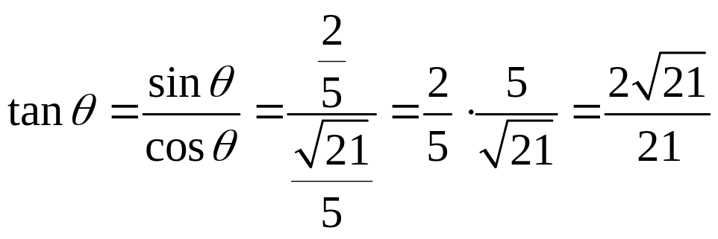

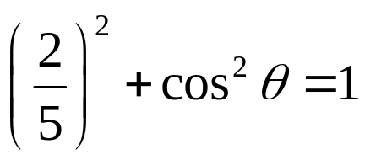
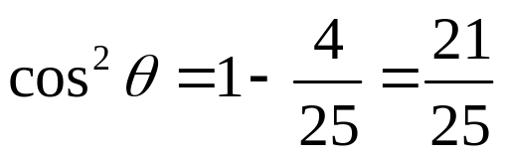
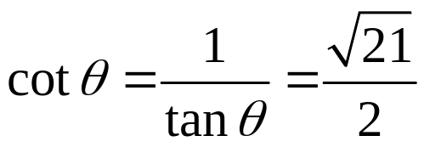
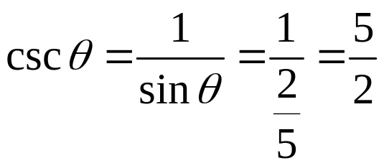
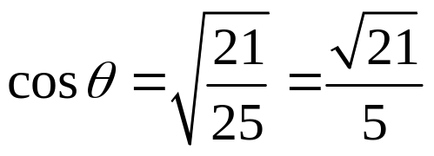
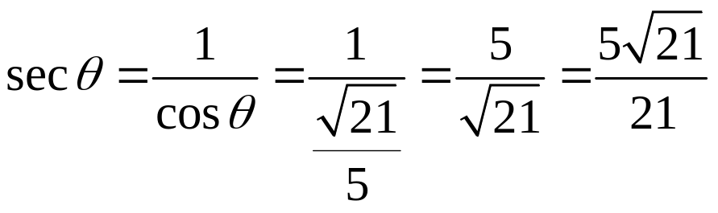
Since θ is acute the trig functions are all positive.

Slide 18
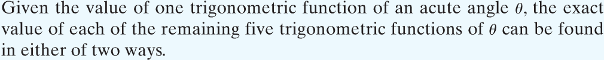
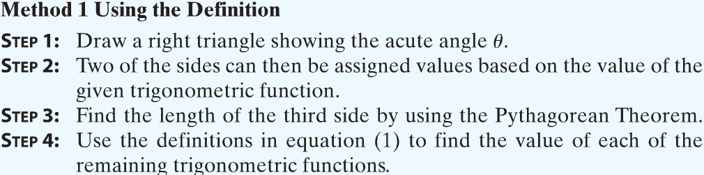
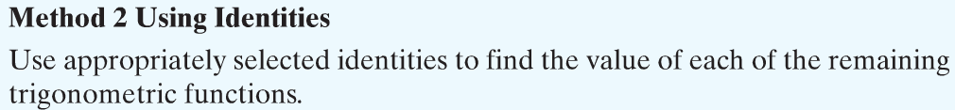
Copyright © 2012 Pearson Education, Inc. Publishing as Prentice Hall.

Slide 19
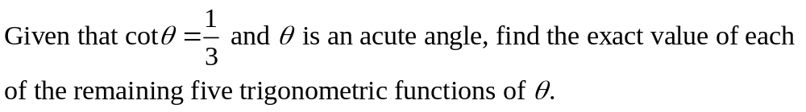
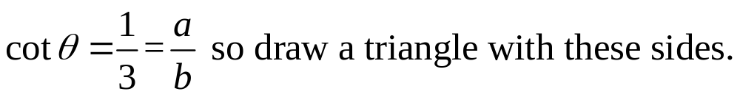

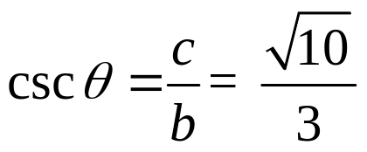

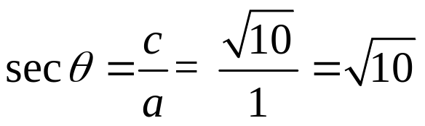
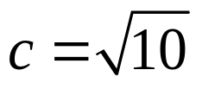
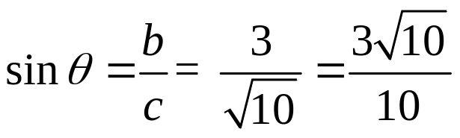
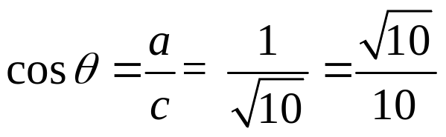
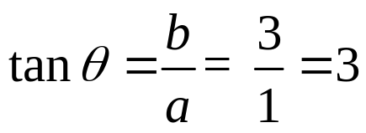
c
b = 3
θ
a = 1
Copyright © 2012 Pearson Education, Inc. Publishing as Prentice Hall.

Slide 20
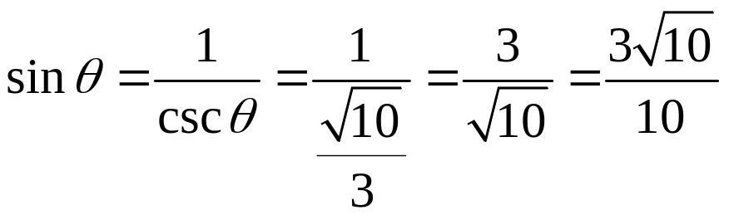

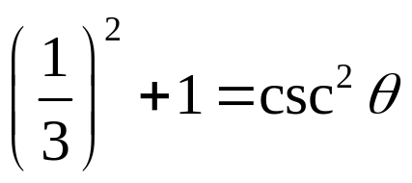





Since θ is acute the trig functions are all positive.
Copyright © 2012 Pearson Education, Inc. Publishing as Prentice Hall.

Slide 21
Copyright © 2012 Pearson Education, Inc. Publishing as Prentice Hall.

Slide 22


Copyright © 2012 Pearson Education, Inc. Publishing as Prentice Hall.

Slide 23


Copyright © 2012 Pearson Education, Inc. Publishing as Prentice Hall.

Slide 24

Copyright © 2012 Pearson Education, Inc. Publishing as Prentice Hall.

Slide 25

Copyright © 2012 Pearson Education, Inc. Publishing as Prentice Hall.

Slide 26


Copyright © 2012 Pearson Education, Inc. Publishing as Prentice Hall.

